Slide 1
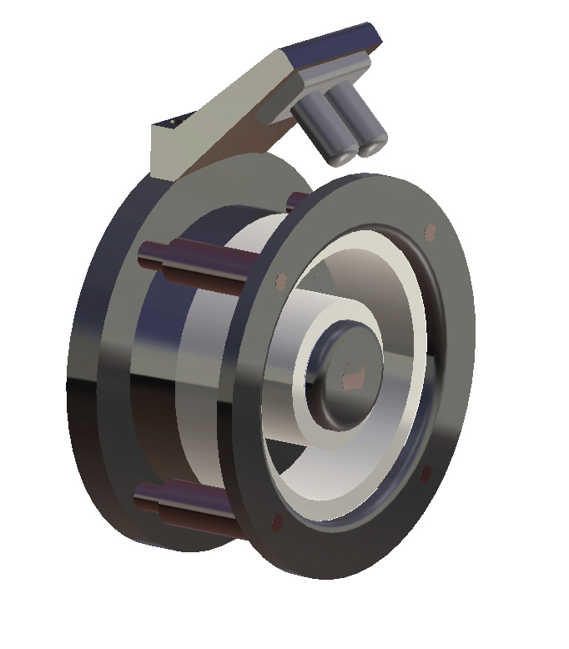
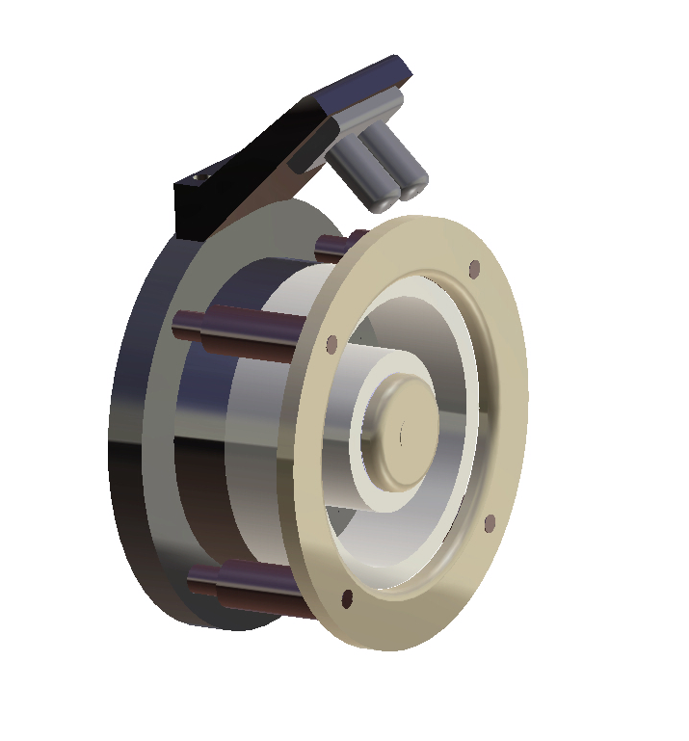

HALL-EFFECT THRUSTER
THRUSTER CAD MODEL & COMPONENTS DRAFT

Slide 2
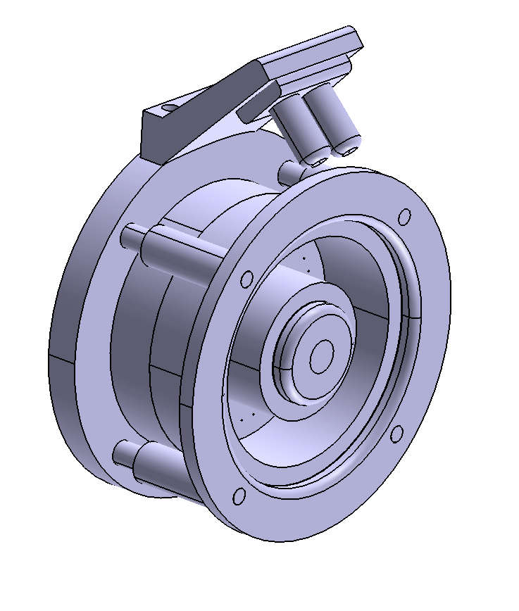
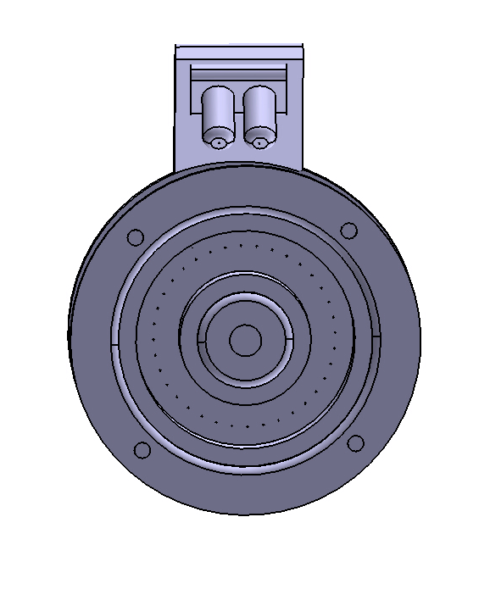
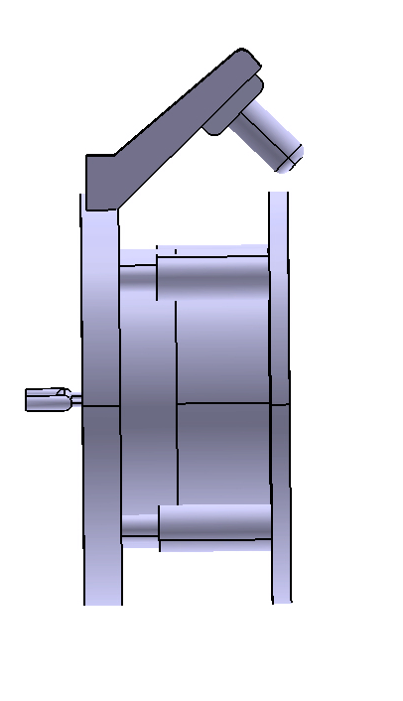
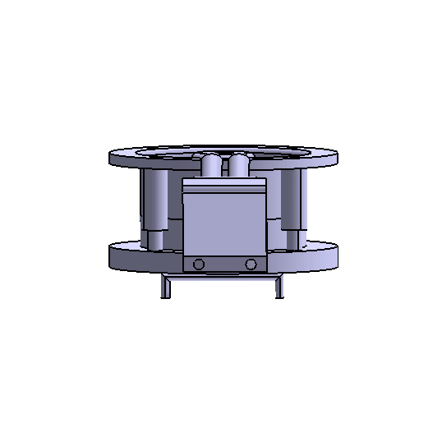
FINAL ASSEMBLY

Slide 3
THRUSTER COMPONENTS DRAFTING
Note: All dimensions are in mm

